Slide 1
Matplotlib

Slide 2
Matplotlib
Matplotlib is an python library which we used to show the data in graphically to the user. We can use this library to get more understand of given data, and we can visualise the given data in histogram ,lline graph and dot markers etc.
There are essentially two ways to use Matplotlib:
Explicitly create figures and axes, and call methods on them (the "object-oriented (OO) style").
Rely on pyplot to automatically create and manage the figures and axes, and use pyplot functions for plotting.

Slide 3
Installation
If we have python then, already we have pip.
With the help of pip we can install the Matplotlib library.
With the simple command we can install the matplotlib.
Type in command prompt:
Pip install matplotlib
If this command fails, then use a python distribution that already has Matplotlib installed, like Anaconda, Spyder etc.

Slide 4
Once Matplotlib is installed, import it in your applications by adding the import module statement:
import matplotlib
Checking Matplotlib Version
The version string is stored under __version__ attribute.
import matplotlib
print(matplotlib.__version__)

Slide 5
Matplotlib Pyplot
Most of the Matplotlib utilities lies under the pyplot submodule, and are usually imported under the plt alias:
import matplotlib.pyplot as plt
Now the Pyplot package can be referred to as plt.
Let's go with the example:

Slide 6
Let’s draw a a line in a diagram from position (0,0) to position (6,250).
import matplotlib.pyplot as plt
import numpy as np
xpoints = np.array([0, 6])
ypoints = np.array([0, 250])
plt.plot(xpoints, ypoints)
plt.show()
And the output will be:

Slide 7
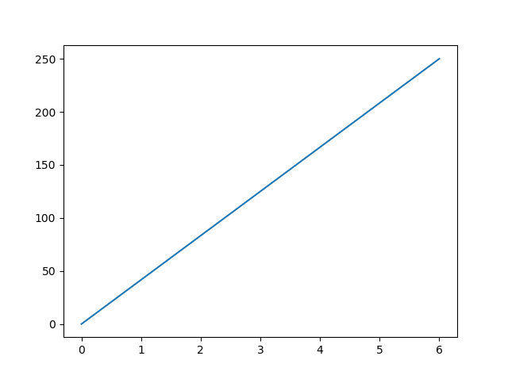
Let’s decode the program,

Slide 8
At 1st line we import Matplotlib from that we call Pyplot and renamed as plt.
2nd line we import numpy library.
Then we give the marking points as an array that why we are importing numpy.After that we tell to pyplot to get the points in graph.
And last line to show the graph.
Next we study more about Plotting.

Slide 9
Matplotlib Plotting
Plotting x and y points
The plot() function is used to draw points (markers) in a diagram.
By default, the plot() function draws a line from point to point.
The function takes parameters for specifying points in the diagram.
Parameter 1 is an array containing the points on the x-axis.
Parameter 2 is an array containing the points on the y-axis.
If we need to plot a line from (1, 3) to (8, 10), we have to pass two arrays [1, 8] and [3, 10] to the plot function.

Slide 10
The x-axis is the horizontal axis.
The y-axis is the vertical axis.
Plotting Without Line
To plot only the markers, you can use shortcut string notation parameter 'o', which means 'rings'.
Example:
Draw two points in the diagram, one at position (1, 3) and one in position (8, 10)

Slide 11
import matplotlib.pyplot as plt
import numpy as np
xpoints = np.array([1, 8])
ypoints = np.array([3, 10])
plt.plot(xpoints, ypoints, 'o')
plt.show()
That ‘o’ there markes the points, without a line. The output will be:

Slide 12
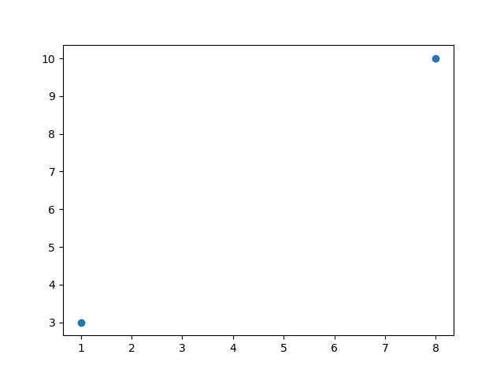
As we can the dotes, which represents our given points.

Slide 13
What about multiple points?
You can plot as many points as you like, just make sure you have the same number of points in both axis.
Eg:
Draw a line in a diagram from position (1, 3) to (2, 8) then to (6, 1) and finally to position (8, 10):

Slide 14
import matplotlib.pyplot as plt
import numpy as np
xpoints = np.array([1, 2, 6, 8])
ypoints = np.array([3, 8, 1, 10])
plt.plot(xpoints, ypoints)
plt.show()
We didn't mention the marker here, so we get a line with these points.
The output be like:

Slide 15
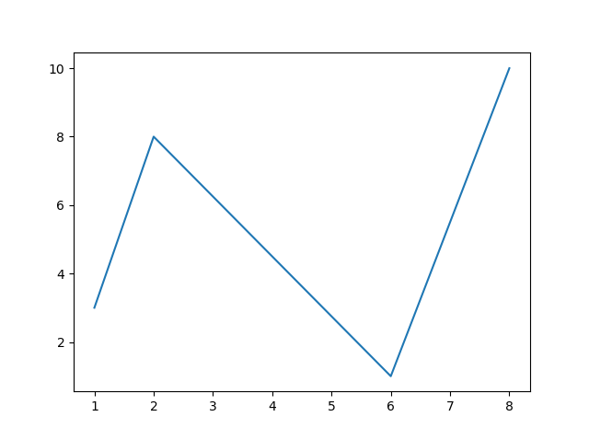
This is what we get after the execution.

Slide 16
Default X-Points
If we do not specify the points in the x-axis, they will get the default values 0, 1, 2, 3, (etc. depending on the length of the y-points.
So, if we take the same example as above, and leave out the x-points, the diagram will look like this:
import matplotlib.pyplot as plt
import numpy as np
ypoints = np.array([3, 8, 1, 10, 5, 7])
plt.plot(ypoints)
plt.show()

Slide 17
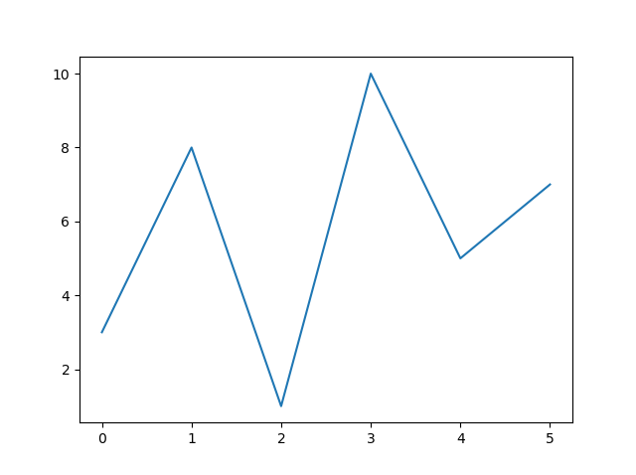
The output will be:
By default it takes x value as 0,1,2,3 ….

Slide 18
Matplotlib Markers
In this section we see more about Markers,
We can use the keyword argument marker to emphasize each point with a specified marker
Eg:
Mark each point with a circle.
import matplotlib.pyplot as plt
import numpy as np
ypoints = np.array([3, 8, 1, 10])
plt.plot(ypoints, marker = 'o')
plt.show()

Slide 19
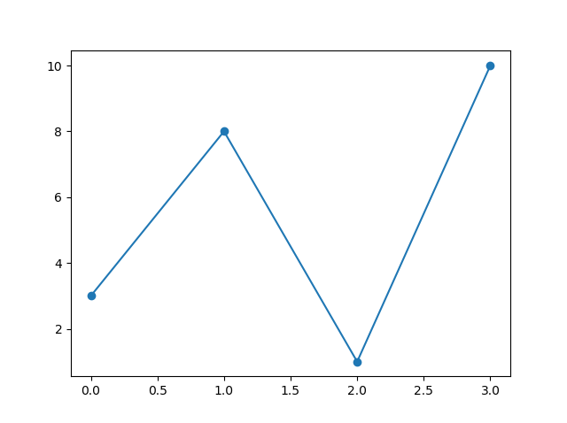
As we can see, we used marker argument , the output will be:
A graph with marker:

Slide 20
We can give any symbol inside the marker keyword,
Eg :
We can give *.
import matplotlib.pyplot as plt
import numpy as np
ypoints = np.array([3, 8, 1, 10])
plt.plot(ypoints, marker = '*')
plt.show()
This way we can change the marker and the output will be:

Slide 21
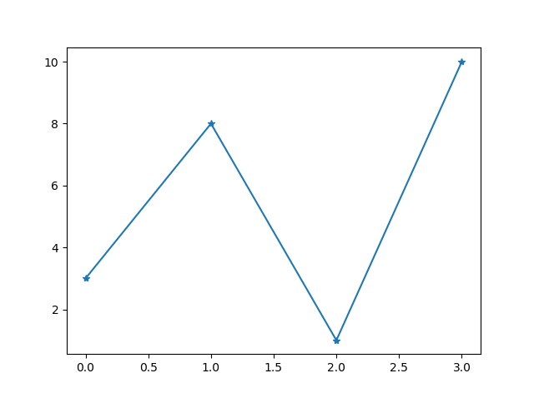
This will be our graph with star sign as marker.

Slide 22
Format Strings fmt
You can use also use the shortcut string notation parameter to specify the marker.
This parameter is also called fmt, and is written with this syntax:
Marker|line|color.
Eg: Mark each point with a circle.

Slide 23
import matplotlib.pyplot as plt
import numpy as np
ypoints = np.array([3, 8, 1, 10])
plt.plot(ypoints, 'o:r')
plt.show()
This will be like that string range giving, so like that we can simply tell the python do give a plot with line as this, marker as this like that.
The output will be :

Slide 24
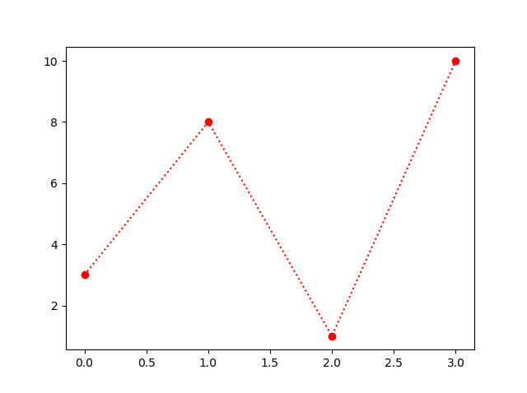
Here we get a dotted line because we ask that, in the format method.

Slide 25
The marker value can be anything from the Marker Reference above.
The line value can be one of the following:
Line Syntax Description
'-' Solid line
':' Dotted line
'--' Dashed line
'-.' Dashed/dotted line
If you leave out the line value in the fmt parameter, no line will be plotted.

Slide 26
The short color value can be one of the following:
Color Syntax Description
'r' Red
'g' Green
'b' Blue
'c' Cyan
'm' Magenta
'y' Yellow
'k' Black
'w' White

Slide 27
Marker Size
You can use the keyword argument markersize or the shorter version, ms to set the size of the markers:
Eg:
Set the size of the markers to 20.
import matplotlib.pyplot as plt
import numpy as np
ypoints = np.array([3, 8, 1, 10])
plt.plot(ypoints, marker = 'o', ms = 20)
plt.show()

Slide 28
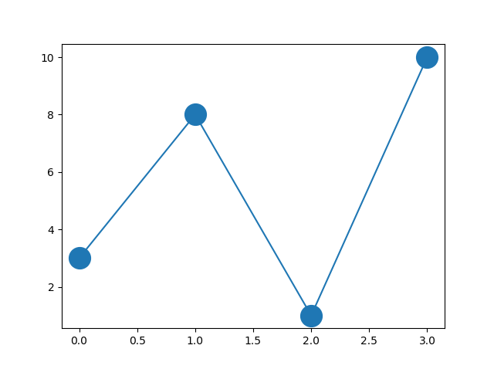
After specify the marker size, the output will be:

Slide 29
Marker Color
You can use the keyword argument markeredgecolor or the shorter mec to set the color of the edge of the markers:
Eg: set the edge colour to red.
import matplotlib.pyplot as plt
import numpy as np
ypoints = np.array([3, 8, 1, 10])
plt.plot(ypoints, marker = 'o', ms = 20, mec = 'r')
plt.show()

Slide 30
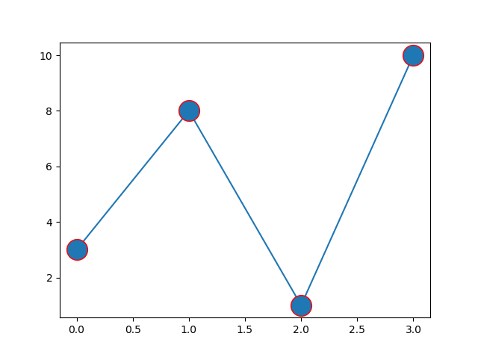
Output will be:

Slide 31
We can change the marker face colour too, by an keyword markerfacecolor or the shorter mfc .
import matplotlib.pyplot as plt
import numpy as np
ypoints = np.array([3, 8, 1, 10])
plt.plot(ypoints, marker = 'o', ms = 20, mec = 'r', mfc = 'r')
plt.show()
Now we can see that we specify both edge and face will be in red.

Slide 32
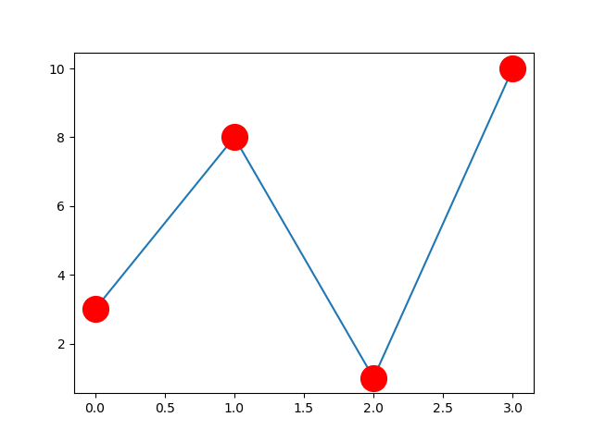

Slide 33
Matplotlib Line
We can set line style , which is we can specify which type of line we want.
The argument used for this will be linestyle, or shorter ls.
import matplotlib.pyplot as plt
import numpy as np
ypoints = np.array([3, 8, 1, 10])
plt.plot(ypoints, linestyle = 'dotted')
plt.show()

Slide 34
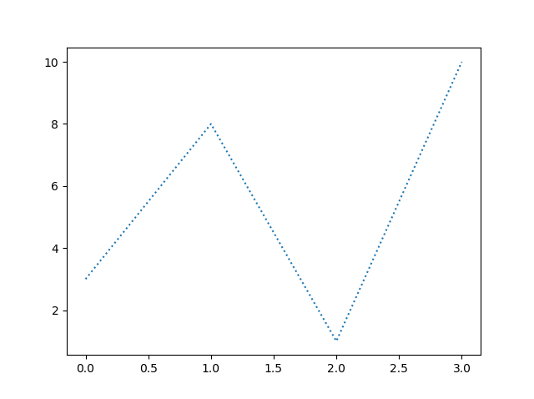
plt.plot(ypoints, linestyle = 'dashed')

Slide 35
Shorter Syntax
The line style can be written in a shorter syntax:
linestyle can be written as ls.
dotted can be written as :
dashed can be written as --.
Line Color
we can use the keyword argument color or the shorter c to set the color of the line:

Slide 36
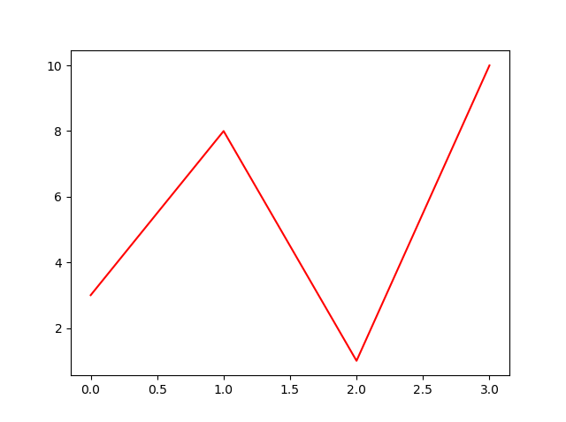
Eg: set line colour to red.
import matplotlib.pyplot as plt
import numpy as np
ypoints = np.array([3, 8, 1, 10])
plt.plot(ypoints, color = 'r')
plt.show()

Slide 37
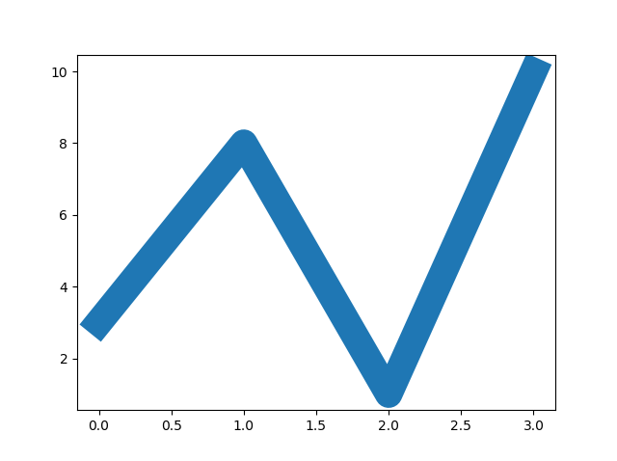
We can specify the line width too, with an keyword linewidth or the shorter lw
Eg:
import matplotlib.pyplot as plt
import numpy as np
ypoints = np.array([3, 8, 1, 10])
plt.plot(ypoints, linewidth = '20.5')
plt.show()
Output will be:

Slide 38
Multiple Lines
We can add multiple lines by adding more plt.plot(), which will be
Eg:
import matplotlib.pyplot as plt
import numpy as np
y1 = np.array([3, 8, 1, 10])
y2 = np.array([6, 2, 7, 11])
plt.plot(y1)
plt.plot(y2)
plt.show()

Slide 39
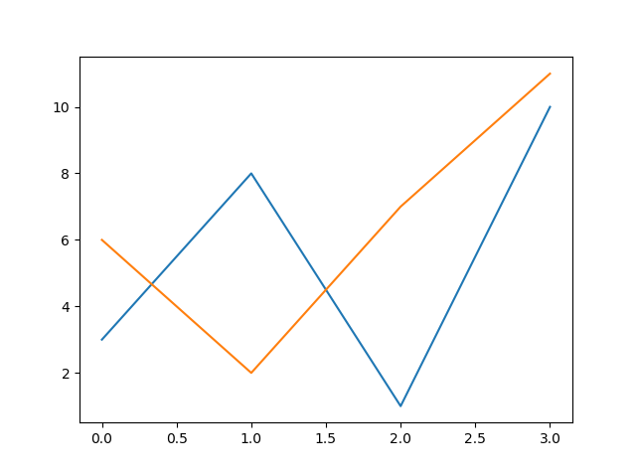
You can also plot many lines by adding the points for the x- and y-axis for each line in the same plt.plot() function.
(In the examples above we only specified the points on the y-axis, meaning that the points on the x-axis got the the default values (0, 1, 2, 3).)
The x- and y- values come in pairs:

Slide 40
import matplotlib.pyplot as plt
import numpy as np
x1 = np.array([0, 1, 2, 3])
y1 = np.array([3, 8, 1, 10])
x2 = np.array([0, 1, 2, 3])
y2 = np.array([6, 2, 7, 11])
plt.plot(x1, y1, x2, y2)
plt.show()

Slide 41
Matplotlib Labels and Title
With Pyplot, we can use the xlabel() and ylabel() functions to set a label for the x- and y-axis.
import numpy as np
import matplotlib.pyplot as plt
x = np.array([80, 85, 90, 95, 100, 105, 110, 115, 120, 125])
y = np.array([240, 250, 260, 270, 280, 290, 300, 310, 320, 330])
plt.plot(x, y)
plt.xlabel("Average Pulse")
plt.ylabel("Calorie Burnage")
plt.show()

Slide 42
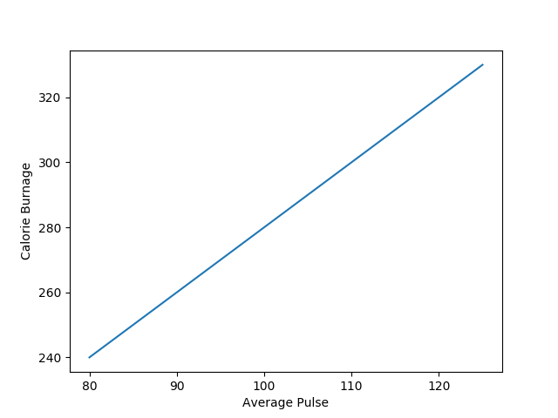
Create a Title for a Plot
With Pyplot, you can use the title() function to set a title for the plot.
Eg:

Slide 43
import numpy as np
import matplotlib.pyplot as plt
x = np.array([80, 85, 90, 95, 100, 105, 110, 115, 120, 125])
y = np.array([240, 250, 260, 270, 280, 290, 300, 310, 320, 330])
plt.plot(x, y)
plt.title("Sports Watch Data")
plt.xlabel("Average Pulse")
plt.ylabel("Calorie Burnage")
plt.show()
output:

Slide 44
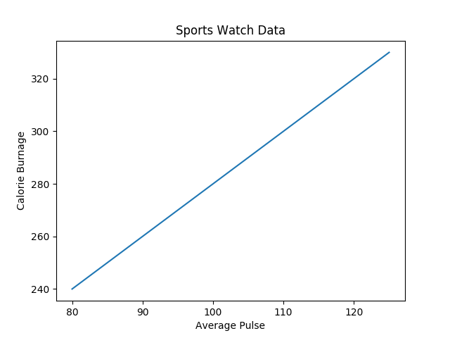
Set Font Properties for Title and Labels
We can use the fontdict parameter in xlabel(), ylabel(), and title() to set font properties for the title and labels.

Slide 45
import numpy as np
import matplotlib.pyplot as plt
x = np.array([80, 85, 90, 95, 100, 105, 110, 115, 120, 125])
y = np.array([240, 250, 260, 270, 280, 290, 300, 310, 320, 330])
font1 = {'family':'serif','color':'blue','size':20}
font2 = {'family':'serif','color':'darkred','size':15}
plt.title("Sports Watch Data", fontdict = font1)
plt.xlabel("Average Pulse", fontdict = font2)
plt.ylabel("Calorie Burnage", fontdict = font2)
plt.plot(x, y)
plt.show()

Slide 46
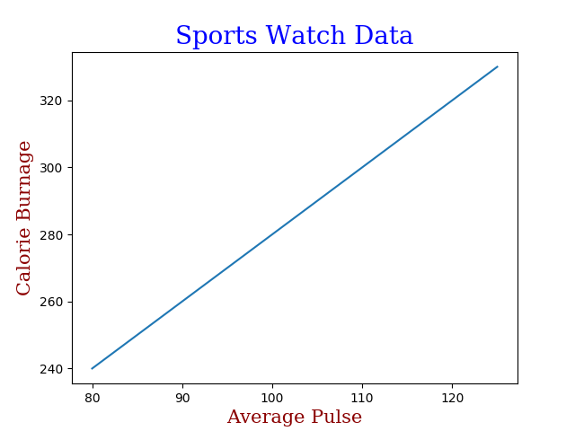
Position the Title
We can use the loc parameter in title() to position the title.
Legal values are: 'left', 'right', and 'center'. Default value is 'center'.

Slide 47
import numpy as np
import matplotlib.pyplot as plt
x = np.array([80, 85, 90, 95, 100, 105, 110, 115, 120, 125])
y = np.array([240, 250, 260, 270, 280, 290, 300, 310, 320, 330])
plt.title("Sports Watch Data", loc = 'left')
plt.xlabel("Average Pulse")
plt.ylabel("Calorie Burnage")
plt.plot(x, y)
plt.show()

Slide 48
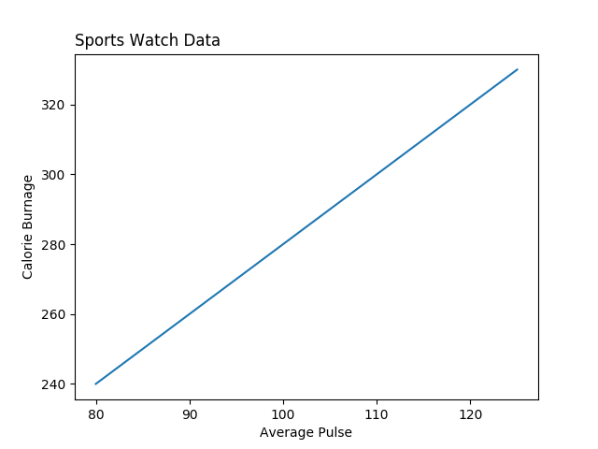

Slide 49
Matplotlib Adding Grid Lines
With Pyplot, you can use the grid() function to add grid lines to the plot.
import numpy as np
import matplotlib.pyplot as plt
x = np.array([80, 85, 90, 95, 100, 105, 110, 115, 120, 125])
y = np.array([240, 250, 260, 270, 280, 290, 300, 310, 320, 330])
plt.title("Sports Watch Data")
plt.xlabel("Average Pulse")
plt.ylabel("Calorie Burnage")
plt.plot(x, y)
plt.grid()
plt.show()

Slide 50

We can use the axis parameter in the grid() function to specify which grid lines to display.
Legal values are: 'x', 'y', and 'both'. Default value is 'both'.

Slide 51
Eg:
Display only grid lines for the x-axis.
import numpy as np
import matplotlib.pyplot as plt
x = np.array([80, 85, 90, 95, 100, 105, 110, 115, 120, 125])
y = np.array([240, 250, 260, 270, 280, 290, 300, 310, 320, 330])
plt.title("Sports Watch Data")
plt.xlabel("Average Pulse")
plt.ylabel("Calorie Burnage")
plt.plot(x, y)
plt.grid(axis = 'x')
plt.show()

Slide 52

Properties of grid
We can also set the line properties of the grid, like this: grid(color = 'color', linestyle = 'linestyle', linewidth = number).

Slide 53
Eg:
set the line properties of grid.
import numpy as np
import matplotlib.pyplot as plt
x = np.array([80, 85, 90, 95, 100, 105, 110, 115, 120, 125])
y = np.array([240, 250, 260, 270, 280, 290, 300, 310, 320, 330])
plt.title("Sports Watch Data")
plt.xlabel("Average Pulse")
plt.ylabel("Calorie Burnage")
plt.plot(x, y)
plt.grid(color = 'green', linestyle = '--', linewidth = 0.5)
plt.show()

Slide 54
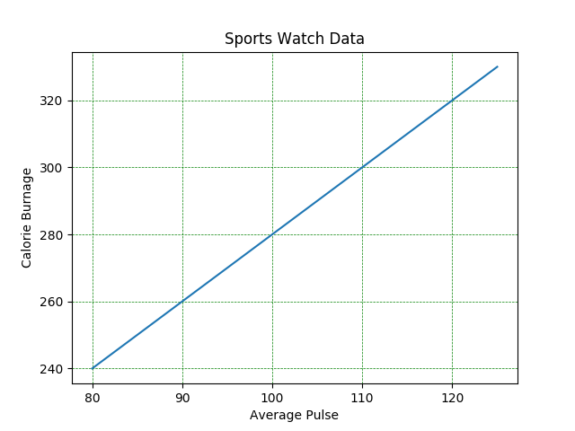

Slide 55
Matplotlib Subplots
What if we need more than one graph, in a single plot.
Which means, subplots.
We can use subplots() function.
Eg;
import matplotlib.pyplot as plt
import numpy as np
#plot 1:
x = np.array([0, 1, 2, 3])
y = np.array([3, 8, 1, 10])
plt.subplot(1, 2, 1)
plt.plot(x,y)

Slide 56
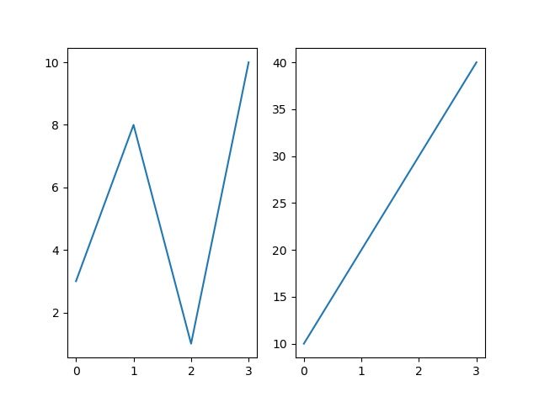
#plot 2:
x = np.array([0, 1, 2, 3])
y = np.array([10, 20, 30, 40])
plt.subplot(1, 2, 2)
plt.plot(x,y)
plt.show()
Output:

Slide 57
plt.subplot(1, 2, 1)
plt.subplot(1, 2, 2)
This two lines here represents the figure and the plots in the figure, which means this 2 lines will decide how many subplots are there and where it need to allocate.
1,2,1 = for 1st subplot
1,2,2 = for 2nd subplot
If we type 1,2,3 there will an error, because It calculated like this:1 * 2 = 2
Maximum subplot will be 2

Slide 58
The subplots() Function
The subplots() function takes three arguments that describes the layout of the figure.
The layout is organized in rows and columns, which are represented by the first and second argument.
The third argument represents the index of the current plot.
plt.subplot(1, 2, 1)
#the figure has 1 row, 2 columns, and this plot is the first plot.
plt.subplot(1, 2, 2)
#the figure has 1 row, 2 columns, and this plot is the second plot.
So, if we want a figure with 2 rows an 1 column (meaning that the two plots will be displayed on top of each other instead of side-by-side), we can write the syntax like this:

Slide 59
import matplotlib.pyplot as plt
import numpy as np
x = np.array([0, 1, 2, 3])
y = np.array([3, 8, 1, 10])
plt.subplot(2, 3, 1)
plt.plot(x,y)
x = np.array([0, 1, 2, 3])
y = np.array([10, 20, 30, 40])
plt.subplot(2, 3, 2)
plt.plot(x,y)
x = np.array([0, 1, 2, 3])
y = np.array([3, 8, 1, 10])
plt.subplot(2, 3, 3)
plt.plot(x,y)

Slide 60
x = np.array([0, 1, 2, 3])
y = np.array([10, 20, 30, 40])
plt.subplot(2, 3, 4)
plt.plot(x,y)
x = np.array([0, 1, 2, 3])
y = np.array([3, 8, 1, 10])
plt.subplot(2, 3, 5)
plt.plot(x,y)
x = np.array([0, 1, 2, 3])
y = np.array([10, 20, 30, 40])
plt.subplot(2, 3, 6)
plt.plot(x,y)
plt.show()

Slide 61
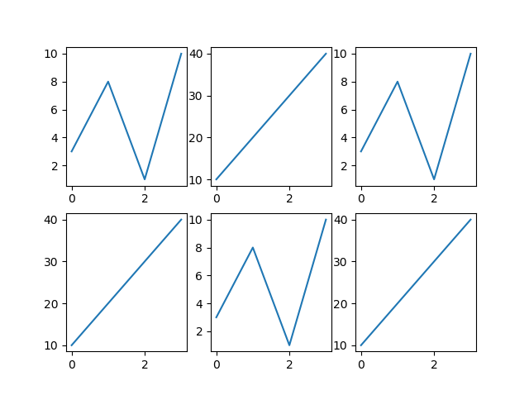
Title
You can add a title to each plot with the title() function:
2 plots, with titles:

Slide 62
import matplotlib.pyplot as plt
import numpy as np
#plot 1:
x = np.array([0, 1, 2, 3])
y = np.array([3, 8, 1, 10])
plt.subplot(1, 2, 1)
plt.plot(x,y)
plt.title("SALES")
#plot 2:
x = np.array([0, 1, 2, 3])
y = np.array([10, 20, 30, 40])
plt.subplot(1, 2, 2)
plt.plot(x,y)
plt.title("INCOME")
plt.show()

Slide 63
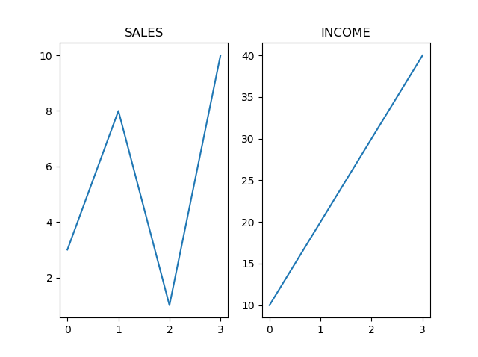
Super Title
You can add a title to the entire figure with the suptitle() function:
Add a title for the entire figure:

Slide 64
import matplotlib.pyplot as plt
import numpy as np
#plot 1:
x = np.array([0, 1, 2, 3])
y = np.array([3, 8, 1, 10])
plt.subplot(1, 2, 1)
plt.plot(x,y)
plt.title("SALES")
#plot 2:
x = np.array([0, 1, 2, 3])
y = np.array([10, 20, 30, 40])
plt.subplot(1, 2, 2)
plt.plot(x,y)
plt.title("INCOME")
plt.suptitle("MY SHOP")
plt.show()

Slide 65
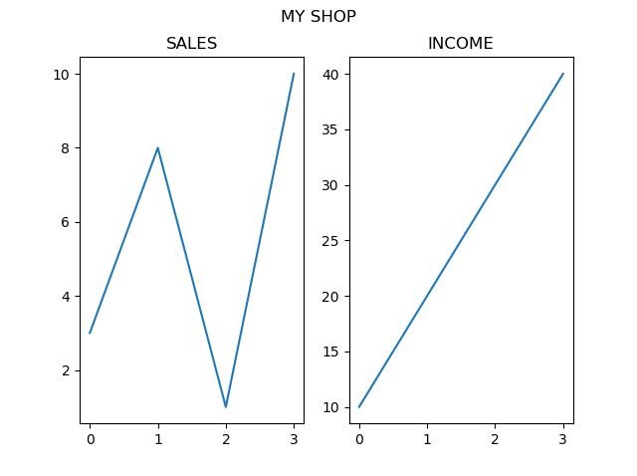

Slide 66
Matplotlib Scatter
With Pyplot, you can use the scatter() function to draw a scatter plot.
The scatter() function plots one dot for each observation. It needs two arrays of the same length, one for the values of the x-axis, and one for values on the y-axis:
A simple scatter plot:
import matplotlib.pyplot as plt
import numpy as np
x = np.array([5,7,8,7,2,17,2,9,4,11,12,9,6])
y = np.array([99,86,87,88,111,86,103,87,94,78,77,85,86])
plt.scatter(x, y)
plt.show()

Slide 67
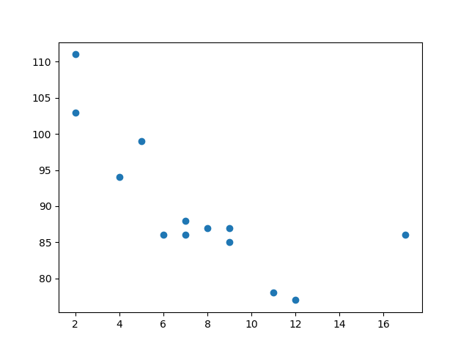
The observation in the example above is the result of 13 cars passing by.
The X-axis shows how old the car is.
The Y-axis shows the speed of the car when it passes.
Are there any relationships between the observations?
It seems that the newer the car, the faster it drives, but that could be a coincidence, after all we only registered 13 cars.

Slide 68
Compare Plots
In the example above, there seems to be a relationship between speed and age, but what if we plot the observations from another day as well? Will the scatter plot tell us something else?
Eg: draw two plots on the same figure
import matplotlib.pyplot as plt
import numpy as np
#day one, the age and speed of 13 cars:
x = np.array([5,7,8,7,2,17,2,9,4,11,12,9,6])
y = np.array([99,86,87,88,111,86,103,87,94,78,77,85,86])
plt.scatter(x, y)
#day two, the age and speed of 15 cars:
x = np.array([2,2,8,1,15,8,12,9,7,3,11,4,7,14,12])
y = np.array([100,105,84,105,90,99,90,95,94,100,79,112,91,80,85])
plt.scatter(x, y)
plt.show()

Slide 69
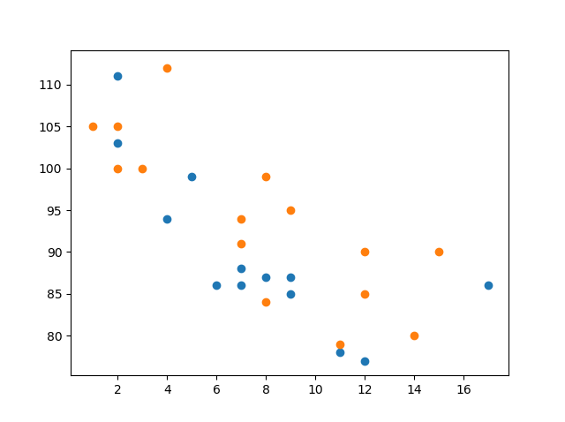
By comparing the two plots, I think it is safe to say that they both gives us the same conclusion: the newer the car, the faster it drives.

Slide 70
Colors
We can set your own color for each scatter plot with the color or the c argument:
Eg:
import matplotlib.pyplot as plt
import numpy as np
x = np.array([5,7,8,7,2,17,2,9,4,11,12,9,6])
y = np.array([99,86,87,88,111,86,103,87,94,78,77,85,86])
plt.scatter(x, y, color = 'hotpink')
x = np.array([2,2,8,1,15,8,12,9,7,3,11,4,7,14,12])
y = np.array([100,105,84,105,90,99,90,95,94,100,79,112,91,80,85])
plt.scatter(x, y, color = '#88c999')
plt.show()

Slide 71
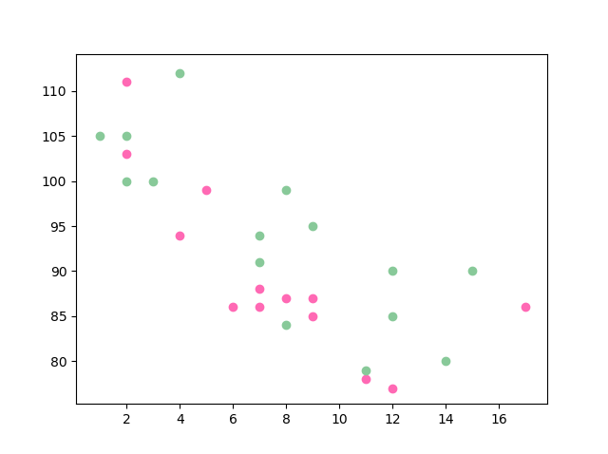
Color Each Dot
We can even set a specific color for each dot by using an array of colors as value for the c argument.
Eg:
Set our own colors of markers.

Slide 72
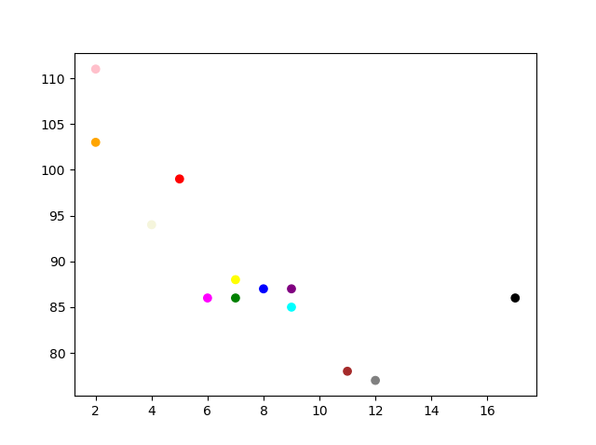
import matplotlib.pyplot as plt
import numpy as np
x = np.array([5,7,8,7,2,17,2,9,4,11,12,9,6])
y = np.array([99,86,87,88,111,86,103,87,94,78,77,85,86])
colors = np.array(["red","green","blue","yellow","pink","black","orange","purple","beige","brown","gray","cyan","magenta"])
plt.scatter(x, y, c=colors)
plt.show()

Slide 73

ColorMap
The Matplotlib module has a number of available colormaps.
A colormap is like a list of colors, where each color has a value that ranges from 0 to 100.
Here is the example of a colormap,

Slide 74
This colormap is called 'viridis' and as you can see it ranges from 0, which is a purple color, and up to 100, which is a yellow color.
How to Use the ColorMap
You can specify the colormap with the keyword argument cmap with the value of the colormap, in this case 'viridis' which is one of the built-in colormaps available in Matplotlib.
In addition you have to create an array with values (from 0 to 100), one value for each of the point in the scatter plot:
Create a color array, and specify a colormap in the scatter plot:

Slide 75
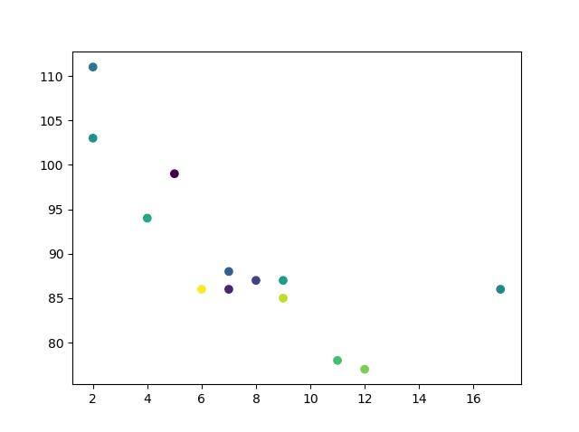
You can include the colormap in the drawing by including the plt.colorbar() statement

Slide 76
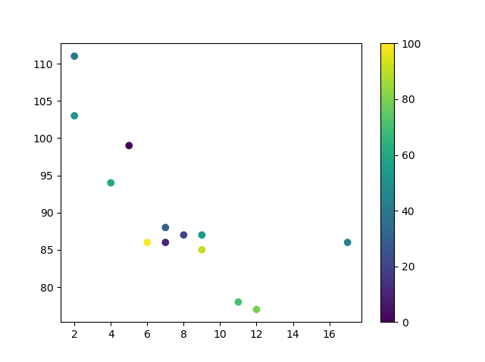
import matplotlib.pyplot as plt
import numpy as np
x = np.array([5,7,8,7,2,17,2,9,4,11,12,9,6])
y = np.array([99,86,87,88,111,86,103,87,94,78,77,85,86])
colors = np.array([0, 10, 20, 30, 40, 45, 50, 55, 60, 70, 80, 90, 100])
plt.scatter(x, y, c=colors, cmap='viridis')
plt.colorbar()
plt.show()

Slide 77
Size
You can change the size of the dots with the s argument.
Just like colors, make sure the array for sizes has the same length as the arrays for the x- and y-axis:
Eg: Set your own size for the markers:
import matplotlib.pyplot as plt
import numpy as np
x = np.array([5,7,8,7,2,17,2,9,4,11,12,9,6])
y = np.array([99,86,87,88,111,86,103,87,94,78,77,85,86])
sizes = np.array([20,50,100,200,500,1000,60,90,10,300,600,800,75])
plt.scatter(x, y, s=sizes)
plt.show()

Slide 78
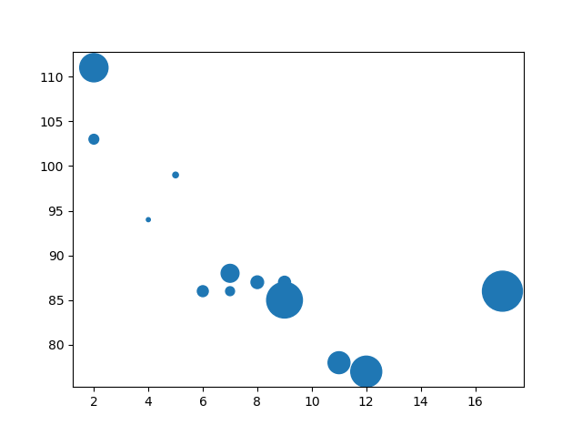
Alpha
You can adjust the transparency of the dots with the alpha argument.
Just like colors, make sure the array for sizes has the same length as the arrays for the x- and y-axis:

Slide 79
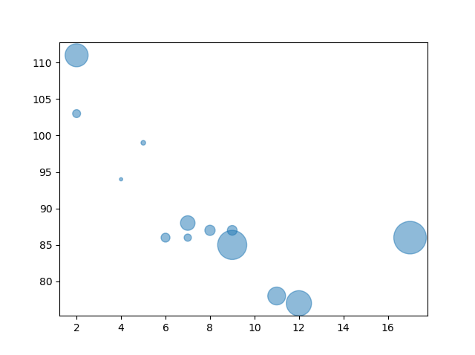
Eg: Set your own size for the markers:
import matplotlib.pyplot as plt
import numpy as np
x = np.array([5,7,8,7,2,17,2,9,4,11,12,9,6])
y = np.array([99,86,87,88,111,86,103,87,94,78,77,85,86])
sizes = np.array([20,50,100,200,500,1000,60,90,10,300,600,800,75])
plt.scatter(x, y, s=sizes, alpha=0.5)
plt.show()

Slide 80
Combine Color Size and Alpha
You can combine a colormap with different sizes on the dots. This is best visualized if the dots are transparent:
Eg: Create random arrays with 100 values for x-points, y-points, colors and sizes:
import matplotlib.pyplot as plt
import numpy as np
x = np.random.randint(100, size=(100))
y = np.random.randint(100, size=(100))
colors = np.random.randint(100, size=(100))
sizes = 10 * np.random.randint(100, size=(100))
plt.scatter(x, y, c=colors, s=sizes, alpha=0.5, cmap='nipy_spectral')
plt.colorbar()
plt.show()

Slide 81
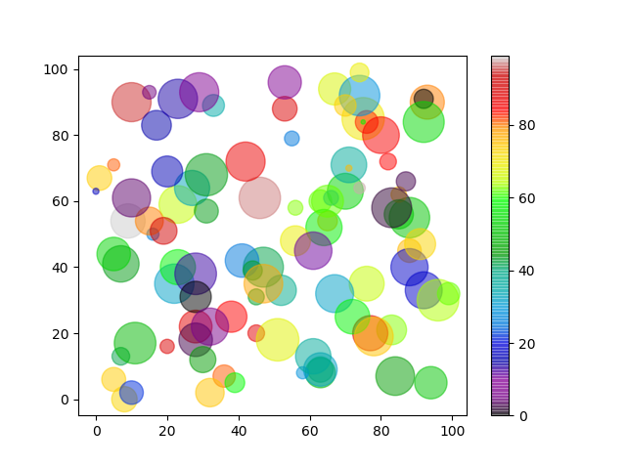

Slide 82
Matplotlib Bars
With pyplot() we can create bar graphs, we can use the bar() function to draw bar graphs .
eg:
import matplotlib.pyplot as plt
import numpy as np
x = np.array(["A", "B", "C", "D"])
y = np.array([3, 8, 1, 10])
plt.bar(x,y)
plt.show()

Slide 83
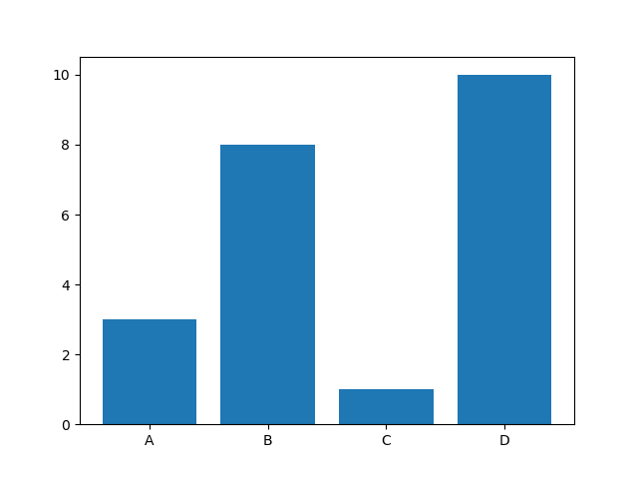
The bar() function takes arguments that describes the layout of the bars.
The categories and their values represented by the first and second argument as arrays.

Slide 84
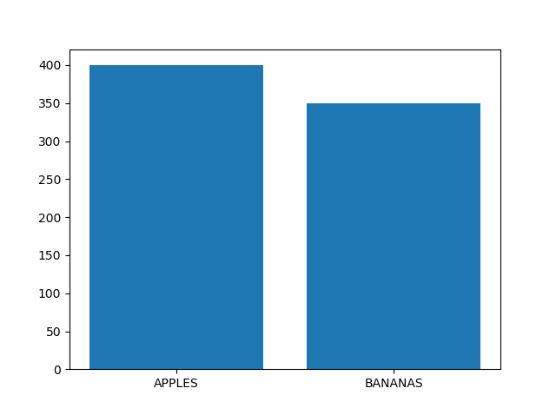
import matplotlib.pyplot as plt
import numpy as np
x = ["APPLES", "BANANAS"]
y = [400, 350]
plt.bar(x, y)
plt.show()

Slide 85
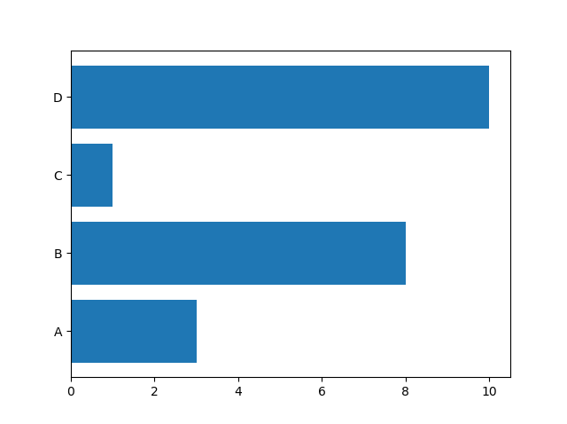
Horizontal Bars
If you want the bars to be displayed horizontally instead of vertically, use the barh() function.
import matplotlib.pyplot as plt
import numpy as np
x = np.array(["A", "B", "C", "D"])
y = np.array([3, 8, 1, 10])
plt.barh(x, y)
plt.show()

Slide 86
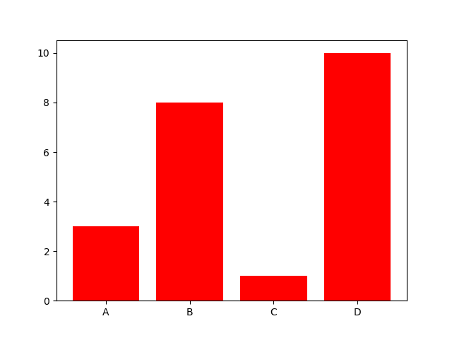
Bar Color
The bar() and barh() takes the keyword argument color to set the color of the bars.
import matplotlib.pyplot as plt
import numpy as np
x = np.array(["A", "B", "C", "D"])
y = np.array([3, 8, 1, 10])
plt.bar(x, y, color = "red")
plt.show()

Slide 87
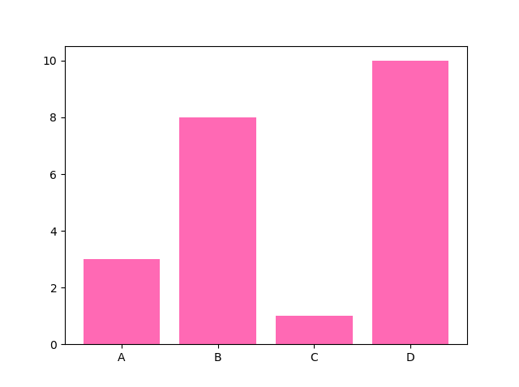
eg:Draw 4 "hot pink" bars
import matplotlib.pyplot as plt
import numpy as np
x = np.array(["A", "B", "C", "D"])
y = np.array([3, 8, 1, 10])
plt.bar(x, y, color = "hotpink")
plt.show()

Slide 88
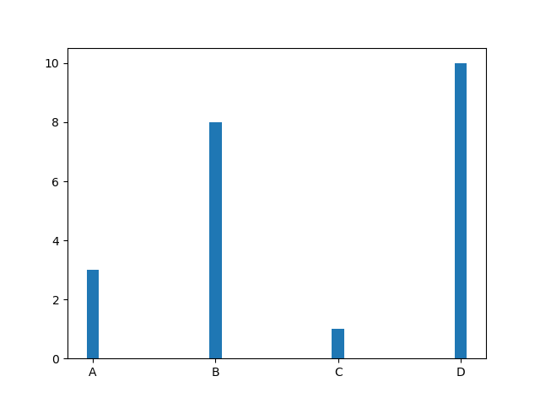
Bar Width
The bar() takes the keyword argument width to set the width of the bars
The default width value is 0.8

Slide 89
Note: For horizontal bars, use height instead of width.
Bar Height
The barh() takes the keyword argument height to set the height of the bars:
Eg:
Draw 4 very thin bars:
import matplotlib.pyplot as plt
import numpy as np
x = np.array(["A", "B", "C", "D"])
y = np.array([3, 8, 1, 10])
plt.barh(x, y, height = 0.1)
plt.show()

Slide 90
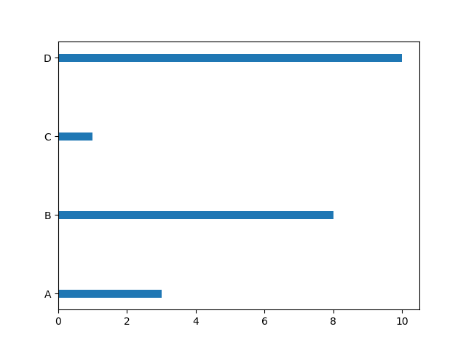
The default height value is 0.8.

Slide 91
Matplotlib Histograms
Histogram
A histogram is a graph showing frequency distributions.
It is a graph showing the number of observations within each given interval.
In Matplotlib, we use the hist() function to create histograms.
The hist() function will use an array of numbers to create a histogram, the array is sent into the function as an argument.

Slide 92
eg:A Normal Data Distribution by NumPy.
import numpy as np
x = np.random.normal(170, 10, 250)
print(x)
This generate an random array output.
But we can't study or understand that data correctly that’s why we use histogram.
The hist() function will read the array and produce a histogram.
import matplotlib.pyplot as plt
import numpy as np
x = np.random.normal(170, 10, 250)
plt.hist(x)
plt.show()

Slide 93
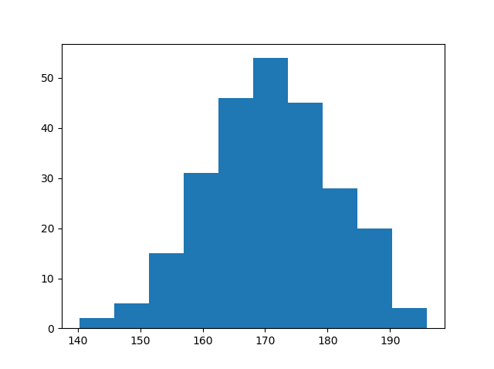
Matplotlib Pie Charts
With Pyplot, you can use the pie() function to draw pie charts.
A simple pie chart:
import matplotlib.pyplot as plt
import numpy as np
y = np.array([35, 25, 25, 15])
plt.pie(y)
plt.show()

Slide 94
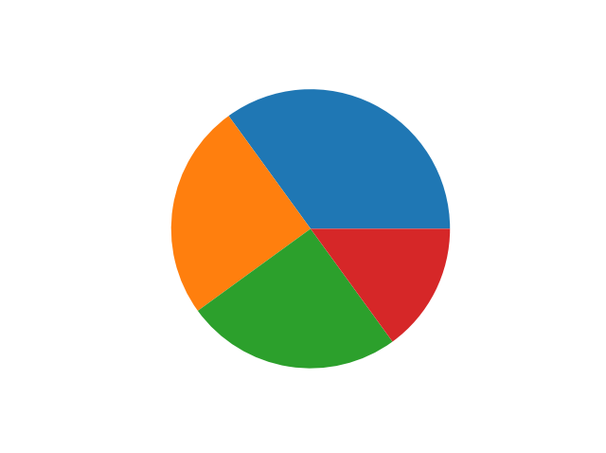
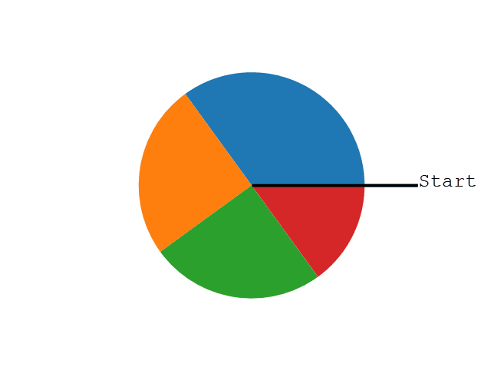
As you can see the pie chart draws one piece (called a wedge) for each value in the array (in this case [35, 25, 25, 15]).
By default the plotting of the first wedge starts from the x-axis and move counterclockwise:

Slide 95
The size of each wedge is determined by comparing the value with all the other values, by using this formula:
The value divided by the sum of all values: x/sum(x).
Labels
Add labels to the pie chart with the label parameter.
The label parameter must be an array with one label for each wedge:
import matplotlib.pyplot as plt
import numpy as np
y = np.array([35, 25, 25, 15])
mylabels = ["Apples", "Bananas", "Cherries", "Dates"]
plt.pie(y, labels = mylabels)
plt.show()

Slide 96
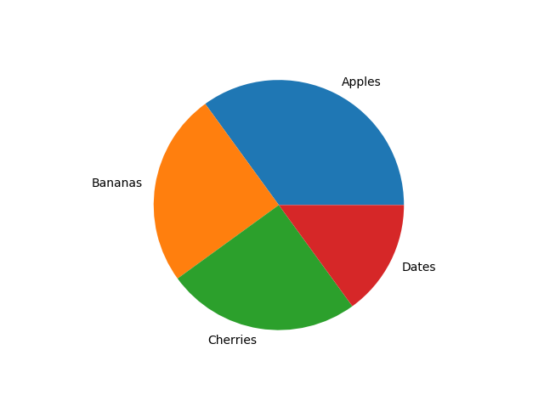
Start Angle
As mentioned the default start angle is at the x-axis, but you can change the start angle by specifying a startangle parameter.
The startangle parameter is defined with an angle in degrees, default angle is 0:
Eg:
Start the first wedge at 90 degrees:

Slide 97
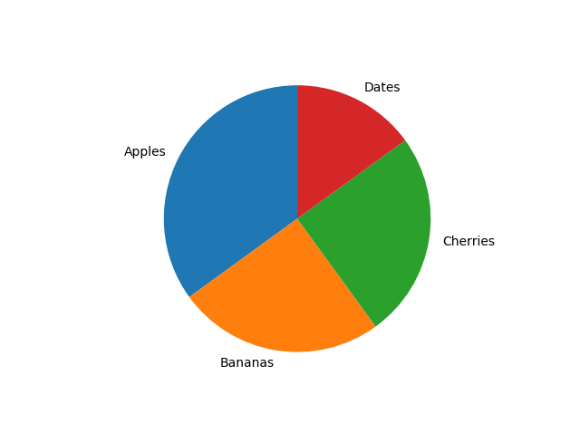
import matplotlib.pyplot as plt
import numpy as np
y = np.array([35, 25, 25, 15])
mylabels = ["Apples", "Bananas", "Cherries", "Dates"]
plt.pie(y, labels = mylabels, startangle = 90)
plt.show()

Slide 98
Explode
Maybe you want one of the wedges to stand out? The explode parameter allows you to do that.
The explode parameter, if specified, and not None, must be an array with one value for each wedge.
Each value represents how far from the center each wedge is displayed:
Eg:
Pull the "Apples" wedge 0.2 from the center of the pie:
import matplotlib.pyplot as plt
import numpy as np
y = np.array([35, 25, 25, 15])
mylabels = ["Apples", "Bananas", "Cherries", "Dates"]
myexplode = [0.2, 0, 0, 0]
plt.pie(y, labels = mylabels, explode = myexplode)
plt.show()

Slide 99
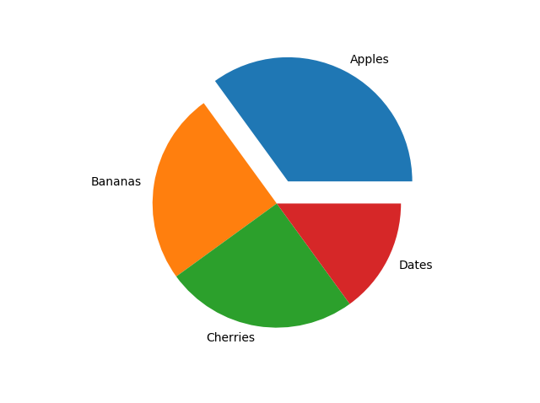
Shadow
Add a shadow to the pie chart by setting the shadows parameter to True:

Slide 100
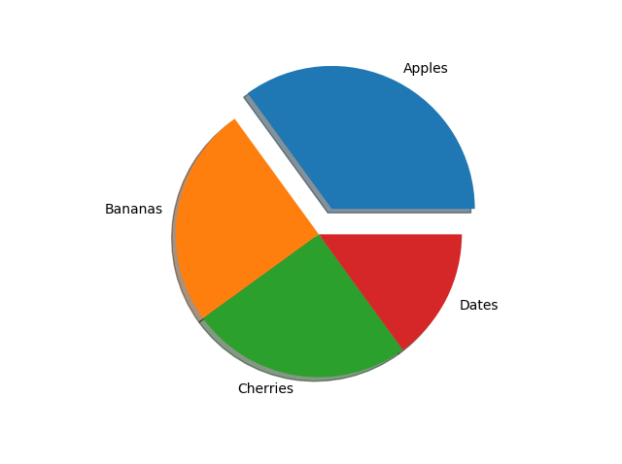
import matplotlib.pyplot as plt
import numpy as np
y = np.array([35, 25, 25, 15])
mylabels = ["Apples", "Bananas", "Cherries", "Dates"]
myexplode = [0.2, 0, 0, 0]
plt.pie(y, labels = mylabels, explode = myexplode, shadow = True)
plt.show()

Slide 101
Colors
You can set the color of each wedge with the colors parameter.
The colors parameter, if specified, must be an array with one value for each wedge:
eg:Specify a new color for each wedge:
import matplotlib.pyplot as plt
import numpy as np
y = np.array([35, 25, 25, 15])
mylabels = ["Apples", "Bananas", "Cherries", "Dates"]
mycolors = ["black", "hotpink", "b", "#4CAF50"]
plt.pie(y, labels = mylabels, colors = mycolors)
plt.show()

Slide 102
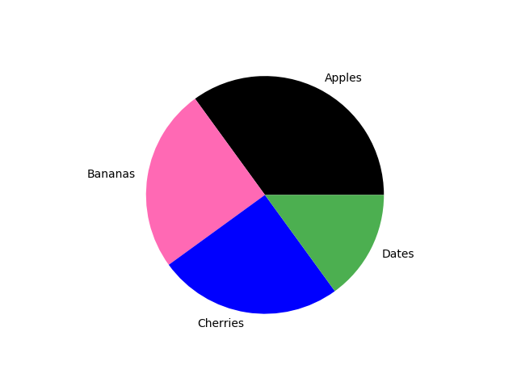
Legend
To add a list of explanation for each wedge, use the legend() function:

Slide 103
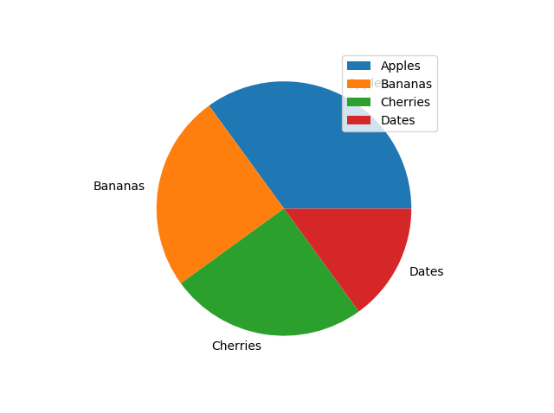
Eg:
Add a legend:
import matplotlib.pyplot as plt
import numpy as np
y = np.array([35, 25, 25, 15])
mylabels = ["Apples", "Bananas", "Cherries", "Dates"]
plt.pie(y, labels = mylabels)
plt.legend()
plt.show()

Slide 104
Legend With Header
To add a header to the legend, add the title parameter to the legend function.
Eg:
Add a legend with a header:
import matplotlib.pyplot as plt
import numpy as np
y = np.array([35, 25, 25, 15])
mylabels = ["Apples", "Bananas", "Cherries", "Dates"]
plt.pie(y, labels = mylabels)
plt.legend(title = "Four Fruits:")
plt.show()

Slide 105
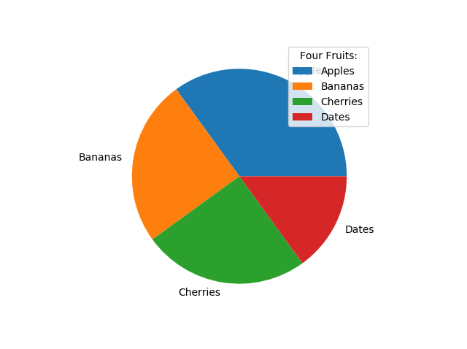

Slide 106
waffle chart
A waffle chart is basically a square display, usually consisting of 100 smaller squares arranged in a 10-by-10 layout.
The squares are colored according to the proportions you are aiming to visualize,
similarly to how you would color different slices of a pie chart. As this square layout somewhat resembles a delicious waffle

Slide 107
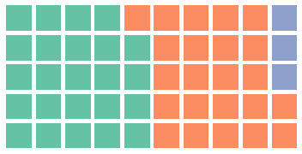
Install library
pip install pywaffle
import matplotlib.pyplot as plt
from pywaffle import Waffle
fig = plt.figure(
FigureClass=Waffle,
rows=5,
columns=10,
values=[48, 46, 6],
figsize=(5, 3)
)
plt.show()

Slide 108

Values in dict & Auto-sizing
data = {'Democratic': 48, 'Republican': 46, 'Libertarian': 3}
fig = plt.figure(
FigureClass=Waffle,
rows=5,
values=data,
legend={'loc': 'upper left', 'bbox_to_anchor': (1.1, 1)}
)
plt.show()

Slide 109

Title, Legend, Colors, Background Color, Block Color, Direction and Style
data = {'Democratic': 48, 'Republican': 46, 'Libertarian': 3}
fig = plt.figure(
FigureClass=Waffle,
rows=5,
values=data,
colors=["#232066", "#983D3D", "#DCB732"],
title={'label': 'Vote Percentage in 2016 US Presidential Election', 'loc': 'left'},
labels=[f"{k} ({v}%)" for k, v in data.items()],
legend={'loc': 'lower left', 'bbox_to_anchor': (0, -0.4), 'ncol': len(data), 'framealpha': 0},
starting_location='NW',
block_arranging_style='snake'
)
fig.set_facecolor('#EEEEEE')
plt.show()

Slide 110

Plot with Icons - Pictogram Chart
data = {'Democratic': 48, 'Republican': 46, 'Libertarian': 3}
fig = plt.figure(
FigureClass=Waffle,
rows=5,
values=data,
colors=["#232066", "#983D3D", "#DCB732"],
legend={'loc': 'upper left', 'bbox_to_anchor': (1, 1)},
icons='child',
font_size=12,
icon_legend=True
)
plt.show()

Slide 111
Word Cloud
Word Cloud is a data visualization technique used for representing text data in which the size of each word indicates its frequency or importance.
Significant textual data points can be highlighted using a word cloud.

Slide 112

Simple wordcloud
Install library
pip install wordcloud
# Libraries
import matplotlib.pyplot as plt
# Create a list of word
text=("'oh oh oh oh oh oh verse wrote book stand title book would life superman thats make feel count
privilege love ideal honored know feel see everyday things things say rock baby truth rock love
rock rock everything need rock baby rock wanna kiss ya feel ya please ya right wanna touch ya
love ya baby night")
# Create the wordcloud object
wordcloud = WordCloud(width=480, height=480, margin=0).generate(text)
# Display the generated image:
plt.imshow(wordcloud, interpolation='bilinear')
plt.axis("off")
plt.margins(x=0, y=0)
plt.show()

Slide 113
THANKYOU

